Slide 2
What’s new with F#
Phillip Carter

Slide 3
Overview
F# 4.6 recap
F# 4.7
F# preview

Slide 4
F# 4.6
Anonymous Records
Tons of performance improvements

Slide 5
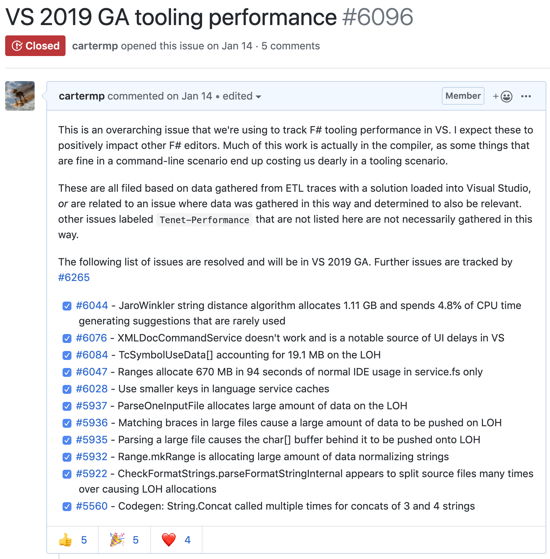
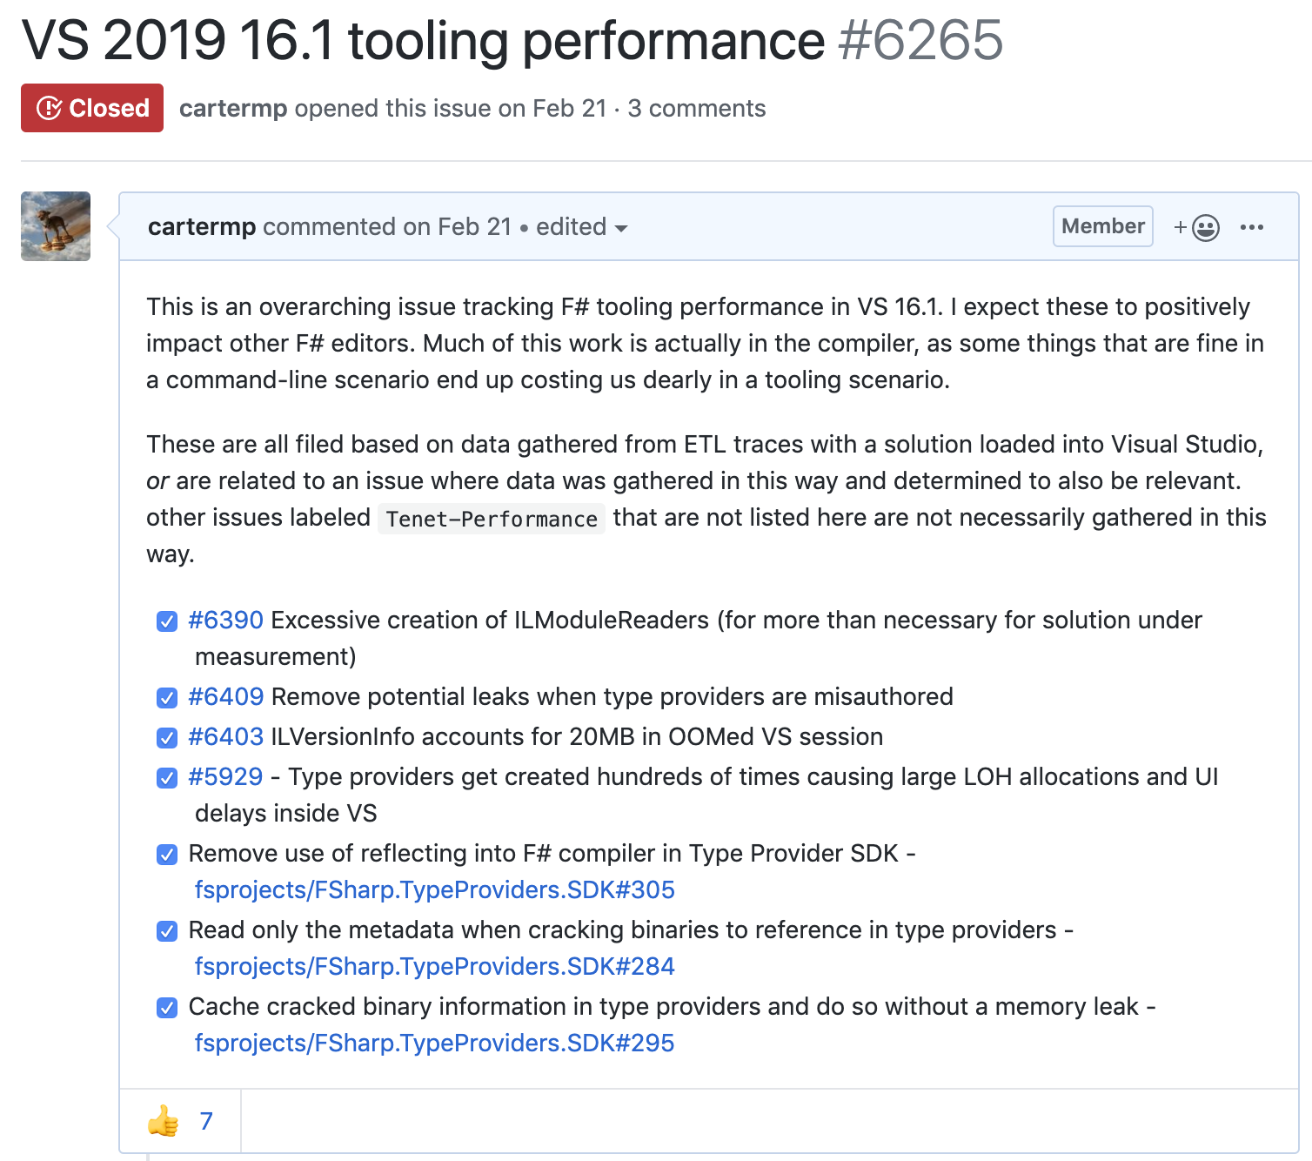
F# 4.6

Slide 6
F# 4.6 in VSCode

Slide 7
F# 4.7 and F# preview
F# 4.7
LangVersion
Implicit yields
Relaxed syntax
F# preview
nameof
Open static classes
dotnet fsi preview

Slide 8
F# 4.7 and F# preview in VS

Slide 9
Summary
F# 4.6
Anonymous Records
Tons of performance improvements
F# 4.7
Making things easier
LangVersion and previews
F# preview
Features, features, features!

Slide 10
Get started with F# 4.7
aka.ms/fsharphome

